Slide 1

ELT Pipeline
Coded Using Python & SQL on a MySQL Database
Connie Sau Chow, John Chen, Chris Garcia

Slide 2
Overview
High Level Overview
Application and Database Architecture
Limitations & Scalability

Slide 3
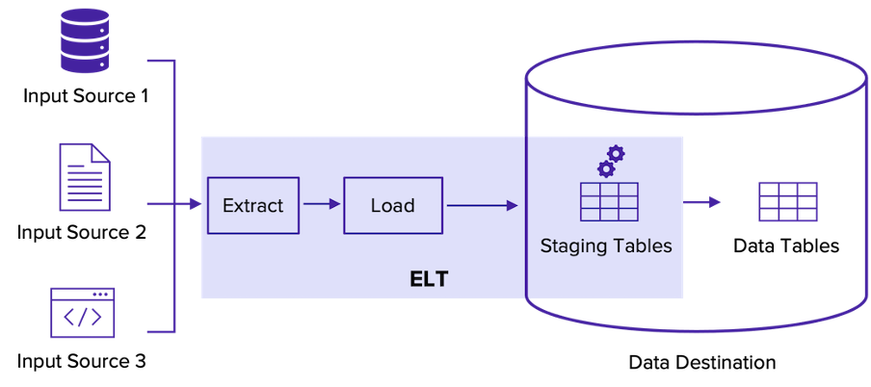
High Level Design & Architecture

Slide 4
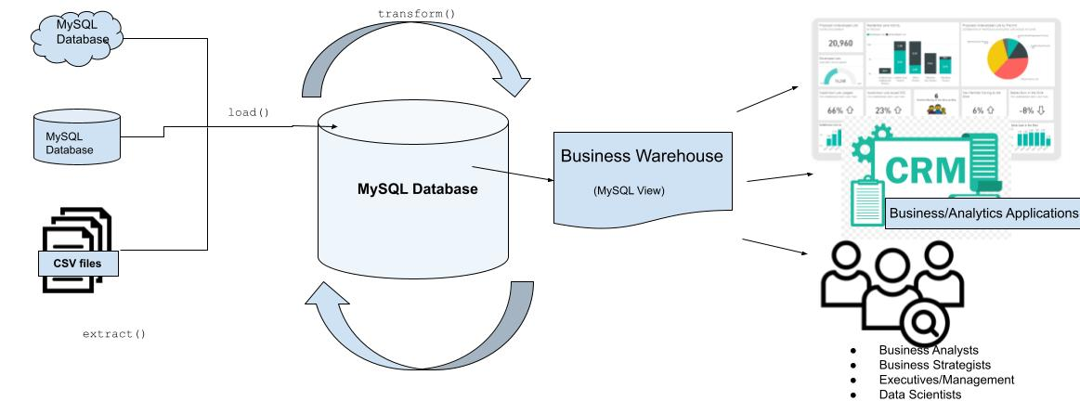
Application Design & Architecture

Slide 5
Data Sources
 | Size | Row Count | Number of Columns
Consumer Expenditures | 337.6 MB | 2,047,961 | 10
Household Members |  | 137,355 | 6
Households |  | 56,812 | 11
GDP | 5.2 KB | 304 | 2
CPI | 22.7 KB | 1,303 | 2

Slide 6
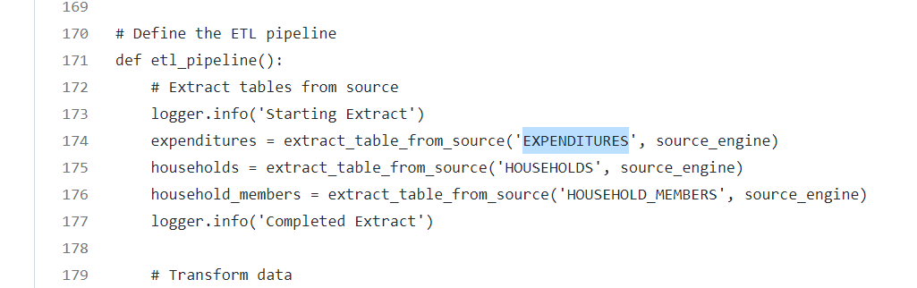
Limitations
Dynamic Extraction of Tables
Hardcoded Table Names

Slide 7
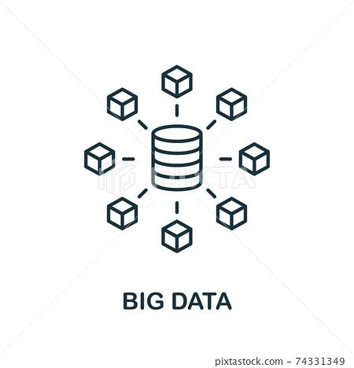

Limitations
Lacks Scalability For Larger Datasets and Data Processing Capacity
Uses Local MySQL Database
Explore other libraries or solutions other than SQLAlchemy

Slide 8


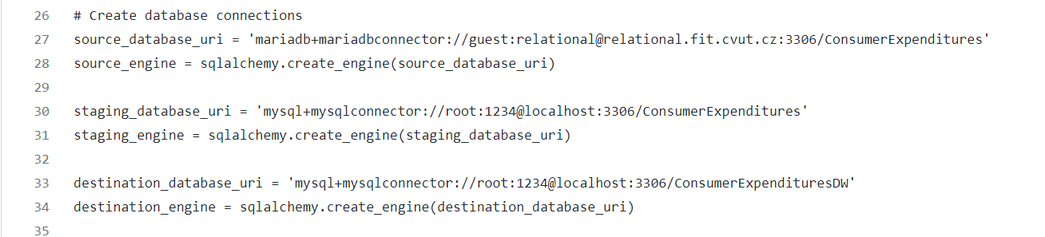
Limitations
Maintainability of Code
Needs centralized configuration file
Needs centralized logging options for different users

Slide 9
Future Implementation Items
More robust ELT pipeline that can scale & integrate
Dynamic extraction of external data sources
Automatic detection of data source types in extraction stage
Configurable Log Files Based on User Requirements
Centralized Configuration File for Storing file locations, etc.

